Slide 1
Recreate MOF based DSC resources
as Class based DSC resources

Slide 2

Get-Help –Name ‘about_Presenter’
Mike F Robbins
Microsoft MVP
Mississippi PowerShell User Group
PowerShell 101: The No-Nonsense Beginner’s Guide
Windows PowerShell TFM 4th Edition
PowerShell Deep Dives
Advanced Category in the 2013 Scripting Games
Learn more about me @ mikefrobbins.com
Notes:
Microsoft MVP on Windows PowerShell
Leader & Co-Founder of Mississippi PowerShell User Group
Author of PowerShell 101: The No-Nonsense Beginner’s Guide
Co-Author of Windows PowerShell TFM 4th Edition
Author of Chapter 6 in the PowerShell Deep Dives book
Winner of the Advanced Category in the 2013 Scripting Games
Learn more about me @ mikefrobbins.com

Slide 3
Write-Output ‘Questions for Audience’
Desired State Configuration
DSC Resources
MOF
Class
Functions and Script Modules
PKI
PowerShell Core
DSC Experts
Notes:
VSCode is a free opensource and lightweight program that’s the new and improved replacement for the PowerShell ISE.
VSCode –ne Visual Studio
PowerShell Core is not an upgrade or replacement to Windows PowerShell. It installs side by side on Windows based systems.

Slide 4
Set-Content ‘Information to Cover’
DSC Resources
Requirements
Basics
MOF Based
Class Based

Slide 5
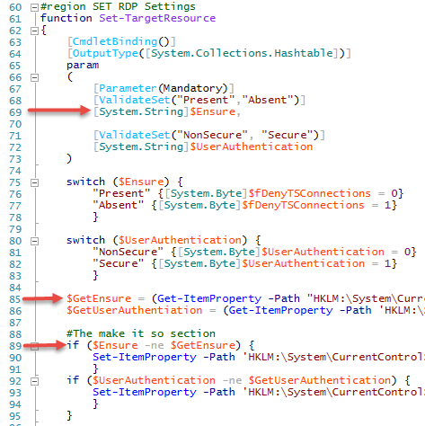
xRemoteDesktopAdmin DSC resource

Slide 6

Start-Process ‘Demo’
Demo Code: github.com/mikefrobbins/Presentations

Slide 7
Select-Object –Property ‘Resources’
PowerShell.org
Microsoft Virtual Academy
PowerShell Magazine
GitHub
User Groups & Blogs
Twitter
Windows Desired State Configuration Revealed book
Learning PowerShell DSC book
The DSC Book

Slide 8




Get-Contact –Identity ‘Presenter’
Blog: mikefrobbins.com (or MrPowerShell.com)
Twitter: @mikefrobbins
LinkedIn: www.linkedin.com/in/mikefrobbins
E-Mail: See mikefrobbins.com/about/
User Group: mspsug.com (or MsPowerShell.com)

